Slide 1
Object Oriented Programming Using Java - Day 2
Intermediate Level

Slide 2
Recap of day 1
  Introduction to Object-Oriented Programming
Object Oriented Concepts
Structured vs OO programming
Java Program Structure and Architecture
Java Language fundamentals

Slide 3
Session Plan – Day 2
Java as an Object Oriented Programming Language
Java Architecture
Java Program Structure
Java Identifiers and Operators
Type Conversion and Casting
Selection Statements
Iteration Statements
Classes and Objects

Slide 4

Day 2 Session Plan
Type Conversion and Casting
Selection Statements
Iteration Statements
Classes and Objects
‘this’ keyword
Notes:
ER/CORP/CRS/LA06/003

Slide 5
Type Conversion, Casting & Control Structures

Slide 6
Type Conversion (1/3)
Type Conversion
  A variable of one type can receive the value of another type
  The data type of the two variables are same
  or
  The data type of the variable receiving data is wider then the data type of the variable from which it is receiving data
Automatic, non-explicit type changing is known as Conversion

Slide 7
Type Conversion (2/3)
  Variable of lower capacity can be assigned to another variable of higher capacity – This is called widening conversion
  Variable of higher capacity can be assigned to another variable of lower capacity – This is called narrowing conversion which may lead to loss of data

Slide 8
Type Conversion (3/3)
Widening Conversion
Narrowing conversion
int i = 10;
double d;
d = i;
In this case there is a compilation error .
Why?
double d = 10.856;
int i;
i = d;
Notes:
Java has a strong type checking. In case of Narrowing conversion there is a possibility of loss of data.
Such type of conversion is not allowed directly but can be done with explicit casting
In case of C language, such type conversions are allowed. Hence we say that C language does not have strong type checking

Slide 9

Type Casting
Whenever a larger type is converted to a smaller type, we have to explicitly specify the type cast operator
  This prevents accidental loss of data
double d = 10;
int i;
i = (int) d;
Type casting
Note: In narrowing conversion typecasting should be done explicitly else it will result in compile time error
Notes:
Type Casting
In some cases, the system implicitly changes the type of an variable without your explicitly performing a cast. You can explicitly change the type of a value by casting. The process of assigning a value of variable to a variable of another type is called casting. Automatic, non-explicit type changing is known as Conversion. If the data types of the two variables involved in the conversion are compatible, then Java does the conversion automatically. If the data types are not same, then a cast must be done explicitly.
E.g.:
An int value can be assigned to a long variable but there is no conversion defined from float to byte.
CastingExample.java
// TYPE CASTING
class CastingExample
{ public static void main(String args[])
{ byte x;
int a=270;
double b =128.128;
System.out.println("\n int converted to byte");
x=(byte) a;
System.out.println("a and x "+ a +" "+x);
System.out.println("\n double converted to int");
a=(int) b;
System.out.println("b and a "+ b +" "+a);
System.out.println("\n double converted to byte");
x=(byte) b;
System.out.println("b and x "+b +" "+x);
}
}
In C programming language, there are many implicit conversions which may lead to loss of data which is restricted in Java using strong typechecking

Slide 10

Selection Statements (1/3)
if
if ( <boolean_expression> )
<statement_or_block>
if-else
if ( <boolean_expression> )
<statement_or_block>
else
<statement_or_block>

Slide 11
Selection Statements (2/3)
if-else-if statement
if ( <boolean_expression> )
<statement_or_block>
else if ( <boolean_expression> )
<statement_or_block>

Slide 12

Selection Statements (3/3)
The switch statement
switch ( <expression> ) {
case <constant1>:
<statement_or_block>*
[break;]
case <constant2>:
<statement_or_block>*
[break;]
default:
<statement_or_block>*
[break;]
}
Notes:
<statement_or_block>* : In this statement ‘*’ represent any number of statements or block

Slide 13


Iteration Statements (1/2)
for
for ( <init_expr>; <test_expr>; <alter_expr> )
<statement_or_block>
while
while ( <test_expr> )
<statement_or_block>

Slide 14

Iteration Statements (2/2)
do-while
do
<statement_or_block>
while ( <test_expr> );

Slide 15
Classes and Objects

Slide 16
Classes & objects
Let us consider a Customer Maintenance application which involves addition of a customer. If the object oriented approach is used, we need to -
  Identify the attributes of the Customer
  Identify the activities
  Identify the exposable attributes and behaviour
We will learn–
How to declare a class with attributes and behaviour
Create objects

Slide 17

Class in UML
Customer
-customerNo :int -customerName :String
+setCustomerNo(int) : void +getCustomerNo() : int +setCustomer Name (String) :String +getCustomer Name ():String
Class Diagram to Java
First Row represents the class name
Second Row represents the attributes/data members
Third Row represents the member functions
- is converted to a private
+ is converted to a public
How would this Class diagram be converted into a Java class?
Notes:
A starter class contains the main method

Slide 18
Class in Java
class Customer{
  private int customerNo;
  private String customerName;
public void setCustomerNo(int no){
customerNo = no;
}
public int getCustomerNo(){
return customerNo ;
}
public void setCustomerName (String name){
customerName = name;
}
public String getCustomerName (){
return customerName ;
}
}
Abstraction & Encapsulation
Identify the OO feature associated with this implementation?
Notes:
A starter class contains the main method
The main method may or may not be present in a class depending on whether it is a starter class or not

Slide 19
Creating Objects
In Java, all objects are created dynamically
  The operator new allocates memory for objects during run time ie. dynamic memory allocation
The following statement creates an object of the class Customer and returns a reference to the newly created object
A reference variable contains a handle to an object
new Customer()
Notes:
A reference/handle is like a pointer to the object. Java however does not allow the programmers to manipulate the references –eg. Does not allow to dereference a reference object.
Creation of objects and arrays are very similar in Java.

Slide 20
Reference variables
Reference variables are used in Java to store the references of the objects created by the operator new
Following syntax can be used to create a reference to a Customer class
A reference type can be assigned ‘null’ to show that it is not referring to any object
  ‘null’ is a keyword in Java
Customer customer;

Slide 21



Reference variable & Object (1/2)
Customer customer;
Reference variable
customer
null
Stack
customer = new Customer();
Allocate Customer object
customer
customerNo
Can an object reference be assigned to another reference variable
customerName
Stack
Heap
Notes:
Answer:Object reference can be assigned to another reference variable.

Slide 22

Reference variable & Object (2/2)
Customer customerOne=customer;
customerOne
customer
customerNo
customerName
Stack
Heap

Slide 23
Reference variables
Even though Java references are similar to C pointers, their usages are different
Pointers | References
Printing a pointer will print the address stored in it | Printing a reference will NOT print the address of the object referred by it
Pointer arithmetic ,like incrementing a pointer is valid in the case of a pointer | Arithmetic operators CANNOT be used on references
A pointer has to be de-referenced using the * operator to get the value pointed by it | A reference is automatically de-referenced to give the data referred by it and no special operator is required for this
Notes:
In order to bring in safer access to memory, manipulation of pointers by the developers in the code is not allowed in Java

Slide 24
Local Variables
Local variables are:
  Variables that are defined inside a method
  Also referred as Local, automatic, temporary, or stack variables
  Created when the method is executed
  Destroyed when the method in which they are declared loses scope
Variable initialization comprises the following:
  Local variables require explicit initialization
Notes:
Naming Conventions
Variable names should be short yet meaningful
One-character variable names should be avoided except for temporary "throwaway" variables
Local variables are stored in the stack memory and hence the name stack variable;
It is automatically created when the method is invoked and destroyed when the method is exited hence local, automatic and temporary variable.

Slide 25
Instance Variables (1/2)
Instance variables (Also known as member variables)
    A variable declared inside a class
    Are not bound to a method
    Belong to the object
    Lifetime depends on the lifetime of the object
    Whenever an object is created, JVM allocates memory for the instance variables
    Stored in the heap memory along with the object to which they belong
Notes:
Instance variables and instance methods are non-static variables and methods in a class which means that they belong to objects whereas static members belong to the class. More on static would be covered on day 3.
Instance variables and instance methods represent the data and the behavior of objects.
Storage part covered later in the slides…
Try to recollect the different segments of memory (Stack, Heap, data and code)from programming course

Slide 26
Instance Variables (2/2)
Instance Variables are two kinds :
  Primitive Variables : Default values ,depending upon data type of variable(Refer table for the default value)
  Reference Variables: Default value is NULL always
Variable | Value
byte | 0
short | 0
int | 0
long | 0L
Variable | Value
float | 0.0F
double | 0.0D
char | ‘\u0000’
boolean | false
Notes:
‘\u0000’ –Represent Unicode Null value

Slide 27



Variables - Example
class Customer{
private int customerNo;
public void setCustomerNo(int no){
customerNo=no;
}
}
class Retail{
public static void main(String args[]){
Customer obj;
obj=new Customer();
obj.setCustomerNo(60);
}
}
Instance variable
Local variable
Reference variable
Notes:
For using a customer object, a programmer need not know the internal implementation details of the class. One needs to know only the public methods to use a Customer object. Abstraction is achieved by hiding the non-essential implementation details and exposing the essential interface details.
If customer is a reference to a Customer object, there exists data members like customer.customerNo and customer.customerName etc. But, these data members are private and hence could not be accessed directly from any code that is written outside the class.

Slide 28
Methods in a class (1/4)
A Method defines an interface to the class
In Java , all the methods should be defined inside the class
Variables(Primitive types) are passed by values to the methods
Objects are passed by reference to the methods
<<Access specifier >> <<Return type >><<MethodName >>(Argument list){
//Behavior
}

Slide 29
Methods in a class (2/4)
class Customer{
int customerNo;
String customerName;
public void setCustomerNo(int no){
customerNo=no;
}
//passed by reference
public void setCustomerNo(Customer obj){
obj.customerNo=2300;
}
public int getCustomerNo(){
return customerNo;
}
}
Setter method
Getter method
Notes:
For using a customer object, a programmer need not know the internal implementation details of the class. One needs to know only the public methods to use a Customer object. Abstraction is achieved by hiding the non-essential implementation details and exposing the essential interface details.
If customer is a reference to a Customer object, there exists data members like customer.customerNo and customer.customerName etc. But, these data members are private and hence could not be accessed directly from any code that is written outside the class. Such code should depend on the public methods to access these data members. These methods are the getter and setter methods to retrieve and initialize data members of a class respectively. Data hiding or encapsulation is thus achieved.

Slide 30
Methods in a class (3/4)
class PassByRef{
public void compare(Customer obj1,Customer obj2){
if(obj1.customerNo==obj2.customerNo){
System.out.println("Duplicate customer Id");
}
else{
System.out.println("Correct Customer Id");
}
}
Can we achieve this in an easier way?
Pass by Value
Customer Number:1300
Pass by Reference
Customer Number:2300
Notes:
Answer: The same thing can be achieved through constructors which is dealt with in the next slide

Slide 31
Methods in a class (4/4)
Can we achieve this in an easier way?
public static void main(String args[]){
Customer customerOne=new Customer();
System.out.println("Pass by Value");
customerOne.setCustomerNo(1300);
System.out.println("Customer Number:"+ customerOne.getCustomerNo());
System.out.println("Pass by Reference");
Customer customerTwo=new Customer();
customerTwo.setCustomerNo(1300);
PassByRef pObj=new PassByRef();
pObj.compare(customerOne,customerTwo);
}
}
Pass by Value
Customer Number:1300
Pass by Reference
Duplicate customer Id
Notes:
Answer: The same thing can be achieved through constructors which is dealt with in the next slide

Slide 32
Constructors
If the data members of the Customer class need to be initialized alongwith object creation, we need to -
  Identify a method which is invoked when the object of a class is created
We will learn –
Constructors

Slide 33
Constructors
A constructor is a special method that has the same name as that of a class
The constructor is used to allocate memory for the instance variables of the class
The programmer can code constructors
The programmer cannot specify an explicit return value
Types of constructors:
  Default constructor
  Parameterized constructor

Slide 34
Default Constructor
If the programmer does not code the constructor explicitly, the system provides a default constructor
  This initializes the instance variables to their default values
Programmer can redefine the default constructor
  Such a constructor does not take any arguments
  The instance variables can be initialized by the user explicitly inside this constructor

Slide 35
Default Constructor (1/2)
class Customer{
int customerNo;
String customerName;
void display(){
System.out.println(“customerNo=”+customerNo);
System.out.println(“customerName=“+customerName);
}
}
class ConExample{
public static void main(String args[]){
Customer customerOne=new Customer();
customerOne. display();
}
}
For the class Customer, no constructor is written so constructor with no parameters will be supplied automatically by java
Default constructor initializes instance variable with default value
customerNo=0 customer Name=null

Slide 36
Default Constructor (2/2)
class Customer{
int customerNo;
String customerName;
Customer(){
customerNo=1300;
customerName="Alphy";
}
void custDisplay(){
System.out.println(“customerNo=“+customerNo);
System.out.println(“customerName=”+customerName);
}
}
class ConExample{
public static void main(String args[]){
Customer customerOne=new Customer();
customerOne.custDisplay();
}
}
Default constructor is redefined and the instance variables are initialized explicitly
customerNo=1300 customerName=Alphy

Slide 37

Parameterized Constructor
The instance variables can be initialized by providing values during object creation
The parameterized constructor is used for this purpose
  Such a constructor takes arguments
  The instance variables are initialized by the programmer explicitly inside this constructor with the values of the arguments

Slide 38
Parameterized Constructor (1/2)
class Customer{
int customerNo;
String customerName;
Customer(int number,String name){
customerNo=number;
customerName=name;
}
}
class ConExample{
public static void main(String args[]){
Customer customerOne=new Customer();
}
}
There is a compilation error Why?.......
Notes:
Answer: Constructor has been called without arguments in this case. If there were no constructors defined , then Java would provide a default constructor. In this case, a parameterized constructor is available and hence there is a compilation error.
This would be dealt in more detail in Method Overloading

Slide 39
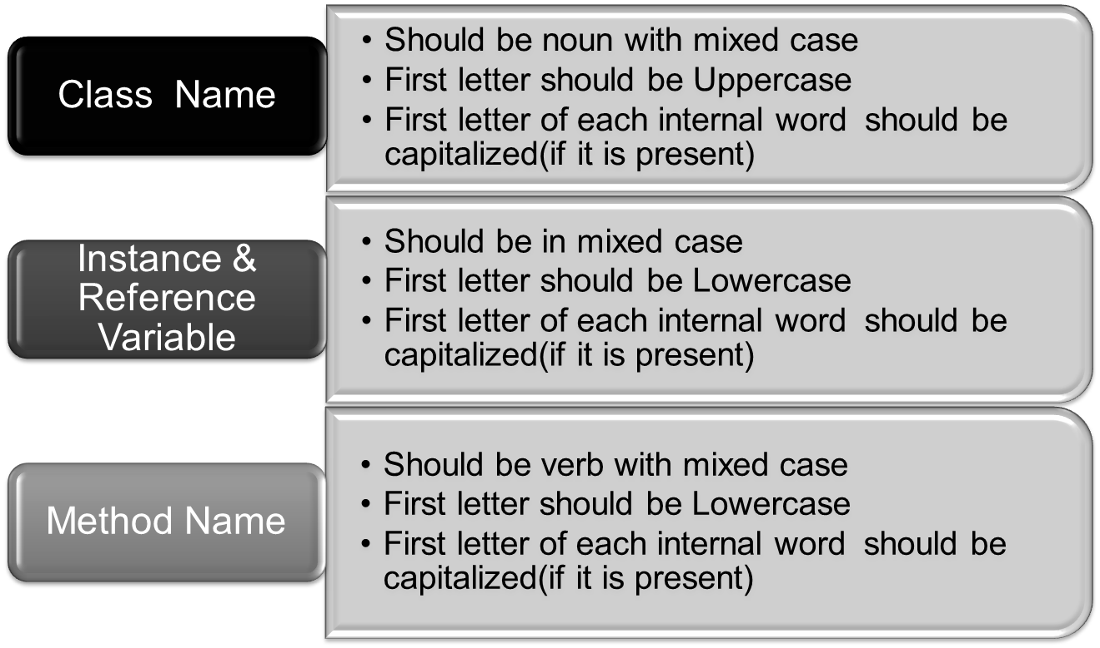
Coding Standards

Slide 40
‘this’ reference (1/2)
When references are instantiated, memory is allocated for the data members. This memory is separately done for each of the references instantiated . However, there is only one copy of the method available for each class . How does the method know that it is invoked by a particular object?
This is possible because every class maintains a ‘this’ reference

Slide 41
‘this’ reference (2/2)
‘this’ is used to refer the current object
Used to resolve ambiguity between instance variables and local variables when they have the same name
(prevents instance variable hiding)
‘this’ reference can be used in some cases to improve the readability of a program
Can be used to invoke the constructor of a class

Slide 42

this – Example (1/4)
class Customer{
int customerNo;
int customerAge;
char customerType;
Customer(int customerNo){
customerNo=customerNo;
}
Customer(char customerType,int customerAge){
customerType=customerType;
customerAge=customerAge;
}
void displayCustomerDetails(){
System.out.println(“Customer No:”+ customerNo);
System.out.println(“Customer Type:”+customerType);
System.out.println(“Customer Age:”+ customerAge);
}
}
The instance variable and local variable have the same name and hence ambiguity while referencing the same
Notes:
this() should be the first statement in the constructor

Slide 43
this – Example (2/4)
class Retail{
public static void main(String args[]){
Customer customer=new Customer(1100);
customer. displayCustomerDetails();
}
}
Why 1100 is not stored in the customerNo
How can constructor be invoked from from another constructor?
Customer No :0
Customer Type :
Customer Age : 0
Notes:
Answer: 1100 is stored in the local variable customerNo not in the instance variable (Local variable scope is only inside the method) and that is why CustomerNo displaying as 0
We can also invoke a constructor from another constructor using this().

Slide 44


this – Example (3/4)
class Customer{
int customerNo;
int customerAge;
char customerType;
Customer(int customerNo){
this(‘R’,26);
this.customerNo=customerNo; variable
}
Customer(char type,int age){
customerType=type;
customerAge=age;
}
void getCustomerDetails(){
System.out.println(“Customer No:”+ customerNo);
System.out.println(“Customer Type:”+customerType);
System.out.println(“Customer Age:”+ customerAge);
}
}
Invoking parameterized constructor
Resolve ambiguity between local variable &instance

Slide 45
this – Example (4/4)
class Retail{
public static void main(String args[]){
Customer customer=new Customer(1100);
customer. getCustomerDetails();
}
}
Customer No :1100
Customer Type :R
Customer Age : 26

Slide 46
Summary
Type Conversion and Casting
Selection Statements
Iteration Statements
Classes and Objects
Constructors – Default and Parameterized
Coding Standards
‘this’ keyword Useful for referring instance variables & calling constructors

Slide 47
Thank You

